Slide 1
Angular Material UI
June 13, 2023
Anuja Ajay - 245235
Rayona Mathew - 245072

Slide 2
Angular Material
Angular Material is a UI component library for Angular JS developers.
Angular Material components offer attractive and consistent designs based on Material Design principles.
They provide ready-to-use UI elements such as buttons, cards, forms, and navigation menus.
Angular Material components are responsive and adapt to different screen sizes and devices.
They adhere to modern web design principles like browser compatibility and device independence.
It helps in creating faster, beautiful, and responsive websites.

Slide 3
Features of Angular Material
In-built responsive designing.
Standard CSS with minimal footprint.
Includes new versions of common user interface controls such as buttons, check boxes, and text fields which are adapted to follow Material Design concepts.
Includes enhanced and specialized features like cards, toolbar, speed dial, side nav, swipe, and so on.
Cross-browser can be used to create reusable web components.

Slide 4
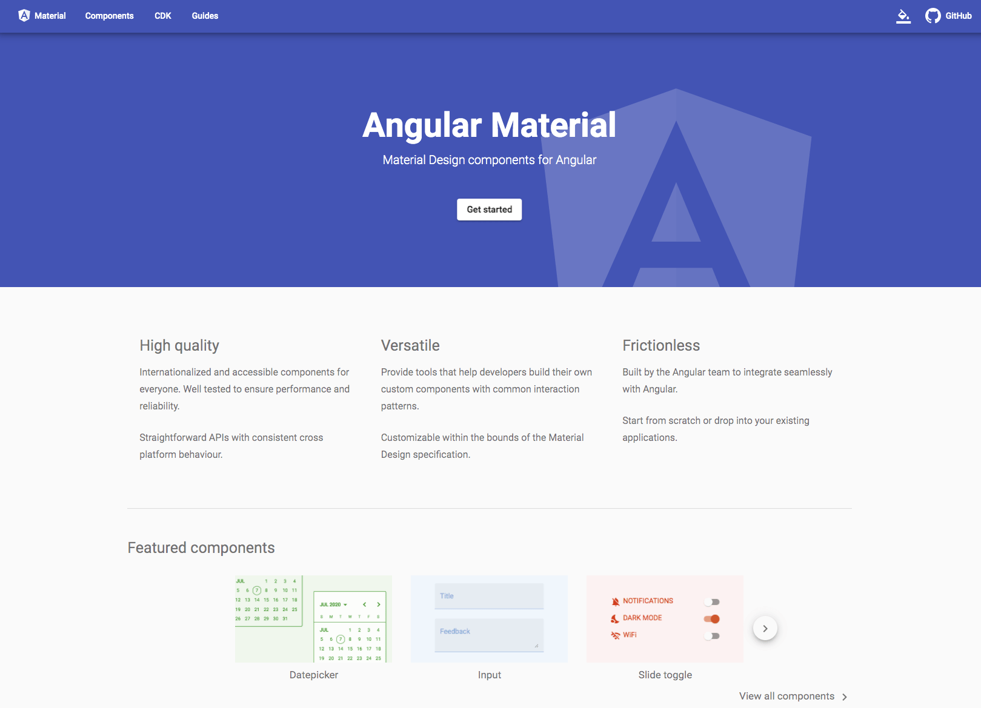
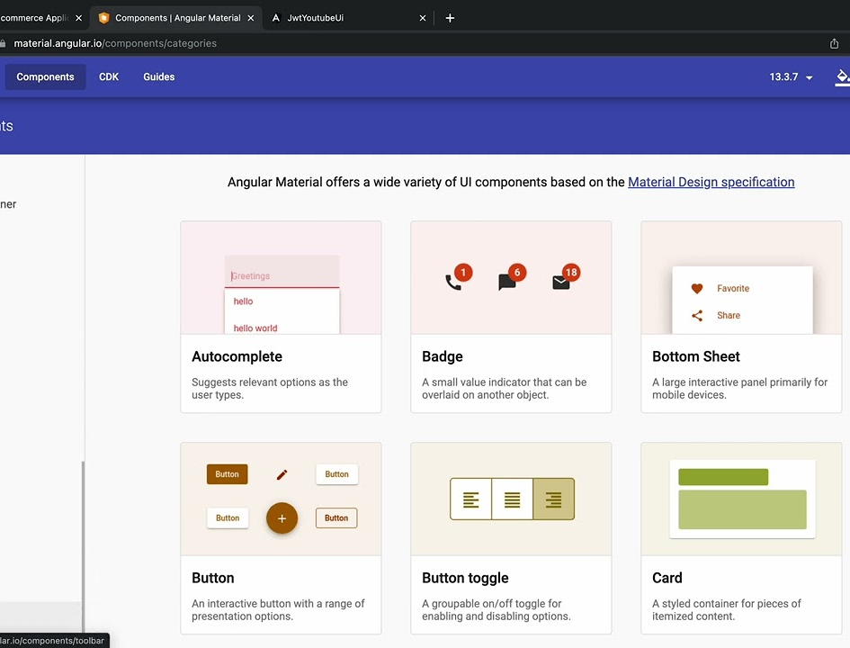
Angular Material UI

Slide 5
Install Angular Material
Use the Angular CLI's install schematic to set up your Angular Material project by running the following command:
ng add @angular/material

Slide 6
Conclusion
Angular Material offers a wide range of pre-built UI components for Angular applications.
It promotes consistent and visually appealing designs throughout the application.
Angular Material enhances the user experience with intuitive and responsive components.
It improves development efficiency by providing time-saving pre-built components.
The library prioritizes accessibility, ensuring inclusive and compliant designs for all users.

Slide 7
References
Angular Material Ui Link : https://material.angular.io/
GitHub Link : https://github.com/anujaajay10/AngularMaterial-SpringBoot.git

